Slide 1
A Short Introduction to Labyrinths
Australian Labyrinth Network Inc.
https://aln.org.au/

Slide 2
What is a Labyrinth?
Take a close look at the image.
A labyrinth is a single path leading to the centre with that same path leading out again. It is a simple path to follow.
Agree?
Things to do: find other designs that fit the definition of a labyrinth.
Australian Labyrinth Network Inc.
https://aln.org.au/

Slide 3
What a Labyrinth is not
Take a close look at the image.
What do you notice? How is a maze different to a labyrinth?
Things to do: find out about the Greek myth, Theseus and the Minotaur. Did Theseus find himself in a labyrinth or a maze?
Justify your response!
Australian Labyrinth Network Inc.
https://aln.org.au/

Slide 4
Labyrinths can be found all over the world.
Some are really old, like 4000 years
Some are as young as today and gone tomorrow
Things to do: find out where ancient labyrinth rock carvings have been found
Australian Labyrinth Network Inc. https://aln.org.au/

Slide 5
Indoors or outdoors, you too can create a labyrinth
Australian Labyrinth Network Inc.
https://aln.org.au/

Slide 6
For outdoors, use…
Rocks or stones
Bricks or pavers
Chalk
Turf paint
Rope
Old shoes filled with plants or succulents
Sticks or fallen tree branches
Autumn leaves
Poly pipe
Australian Labyrinth Network Inc.
https://aln.org.au/

Slide 7
For indoors, use
Tape
Rope
Scarves
Streamers
Chalk on carpet
Paper shapes
Books
Pegs
Paint on dropsheets
Sand
Things to do:
find some pictures of labyrinths and choose 3 that you really like.
Give reasons for your choices.
Australian Labyrinth Network Inc.
https://aln.org.au/

Slide 8
Finger labyrinths
Finger labyrinths can be used indoors or outdoors.
They are portable and can be unique creations of your very own.
To make one, use pencils, paint, clay, pipe cleaners, buttons, Lego, wool, sand tray, glue and glitter, toys, leaves, seed pods, …
The next slide has information about how to draw the design
Australian Labyrinth Network Inc. https://aln.org.au/

Slide 9
This video will help you draw a labyrinth
Lars Howlett showing Classical Labyrinth Seed Patterns
Australian Labyrinth Network Inc. https://aln.org.au/

Slide 10
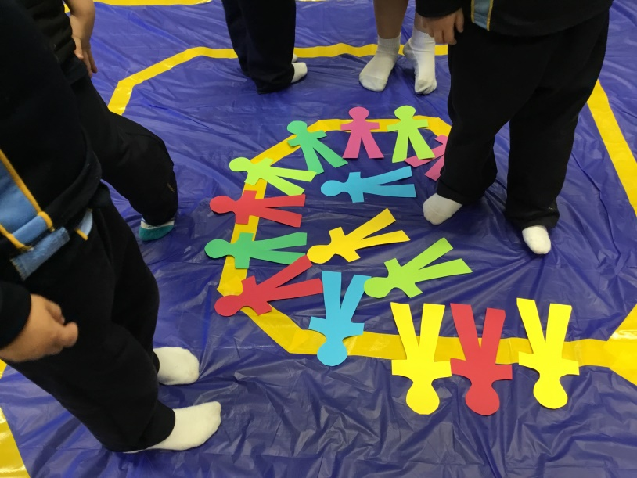
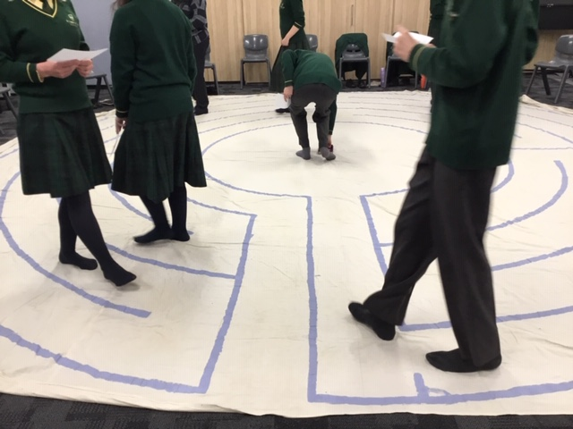
Using a labyrinth - you cannot lose your way in a labyrinth
Begin at the entrance and simply follow the path on your journey to the centre.
There is no right or wrong way to walk a labyrinth.
You may choose to pause, reflect or meditate at various points along the path or in the centre.
When ready, return outwards retracing your steps.
Australian Labyrinth Network Inc.
https://aln.org.au/

Slide 11
Now it’s over to you…
happy investigating
happy drawing
happy making
happy walking
Alone or with others, enjoy your times on the labyrinth!
Australian Labyrinth Network Inc.
https://aln.org.au/

Slide 12
Labyrinths in Educational Settings
https://aln.org.au/
Prepared by the Australian Labyrinth Network – Labyrinths in Education Settings Working Group - for World Labyrinth Day in Schools 2021 … and beyond ….

